Slide 1
Broken Authentication and Session Management
Web Vulnerabilities and Hardening Day 3
1

Slide 2

Class Objectives
By the end of class, you will be able to:
Exploit broken access controls by executing a client-side JavaScript validation bypass attack.
Exploit broken authentication by executing attacks on insecure login forms attacks, logout
management, and administrative portals.
Use WebScarab and CyberChef to manipulate cookies and execute command injection.
Provide mitigation strategies for all attacks executed.
2

Slide 3

Offense Informs Defense
Throughout this unit, we will act out examples of malicious attacks to show how various hacks and exploits work and how we can better defend against them.
It is important to note that the skills we learn in offensive security units should only be used ethically and with permission.
The actions and intents of criminal hackers, hacktivists and other malicious actors that we mimic for demonstrations are in no way condoned or encouraged.
Notes:
shutterstock_220231387

Slide 4

Validation Bypass
Any actor or group can be a threat agent for exploiting access controls.
4

Slide 5

Restrictions on what authenticated users are allowed to do are often not properly enforced. Attackers can exploit these flaws to access unauthorized functionality and/or data, such as access other users’ accounts, view sensitive files, modify other users’ data, change access rights, etc.
—OWASP Top 10

Slide 6

Validation Bypass
Security code analysis tools and vulnerability scanning tools can detect a lack of access controls.
resources.infosecinstitute.com

Slide 7
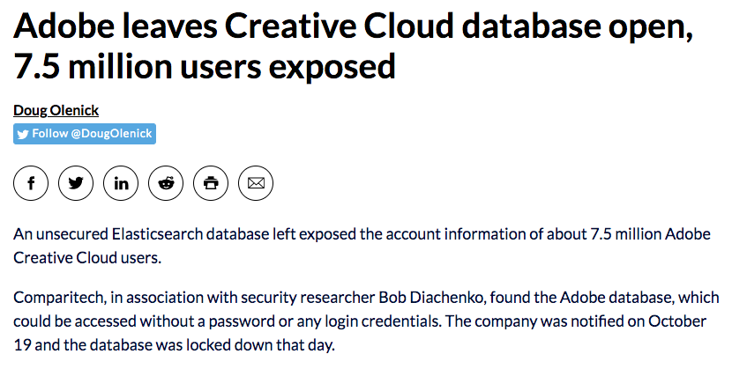

Validation Bypass
Weak access control mechanisms result from a lack of automated detection and a lack of proper testing by application developers.
Adobe leaves Creative Cloud database open, 7.5 million users exposed
Doug Olenick
An unsecured Elasticsearch database left exposed the account information of about 7.5 million Adobe Creative Cloud users.
Comparitech, in association with security researcher Bob Diachenko, found the Adobe database, which could be accessed without a password or any login credentials. The company was notified on October 19 and the database was locked down that day.
Follow @DougOlenick
scmagazine.com

Slide 8
Validation Bypass
Manual testing can also detect missing or ineffective access controls such as proper HTTP GET and PUT methods.
HTTP Method | Description
GET | Requests data from a server.
POST | Sends data to a source, often changing or updating a server.
PUT | Replaces current data with the new value.
DELETE | Deletes a specified resource.
CONNECT | Establishes a tunnel to the server.
OPTIONS | Lists the communication options for target resource.

Slide 9

Validation Bypass
Some common access control vulnerabilities include bypassing access control checks by:
Manipulating the URL.
Modifying the HTML code on a webpage.
Using a custom API attack tool.
Manipulating hidden form fields or cookies.
9

Slide 10

Validation Bypass
Validation bypass exploits mostly affect confidentiality and integrity of the CIA triad.
1
Availability
2
Integrity
INFORMATION
SECURITY
3
Confidentiality

Slide 11
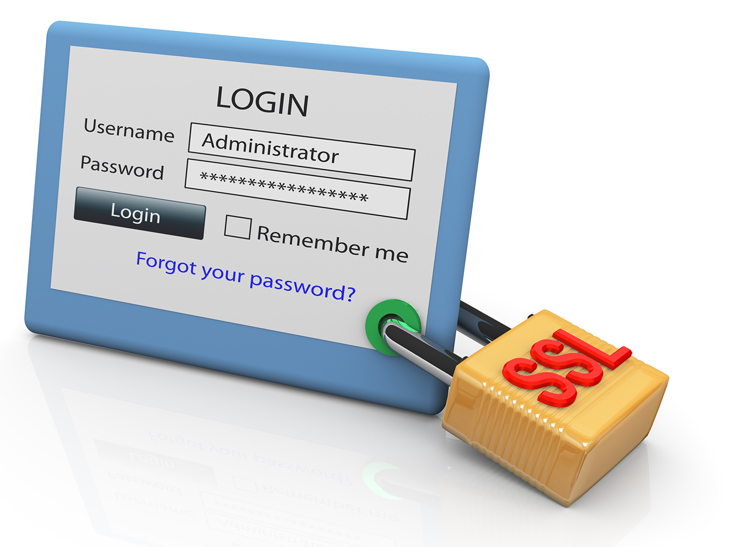
Validation Bypass
Attackers can use validation bypass breaches to assume the identity of users
or administrators with escalated privileges, allowing them to create, access, update, or delete data.
Notes:
shutterstock_76941778

Slide 12

Validation Bypass
Command vulnerability bypass attacks can also result in a complete takeover. The degree of impact depends on the business needs of the data and the application it runs on.
2 Million IoT Devices Vulnerable to Complete Takeover By Lindsey O'Donnell
Millions of security cameras, baby monitors and “smart” doorbells are open to hijack—and no solution is currently available.
Over 2 million IP security cameras, baby monitors and smart doorbells have serious vulnerabilities that could enable an attacker to hijack the devices and spy on their owners—and there’s currently no known patch for the shared flaws.
threatpost.com

Slide 13
Now we’ll demonstrate how to exploit access control vulnerabilities on client-side JavaScript.
13
Notes:
Image source: shutterstock_1083618569

Slide 14
Client-Side JavaScript Validation Bypass
14

Slide 15
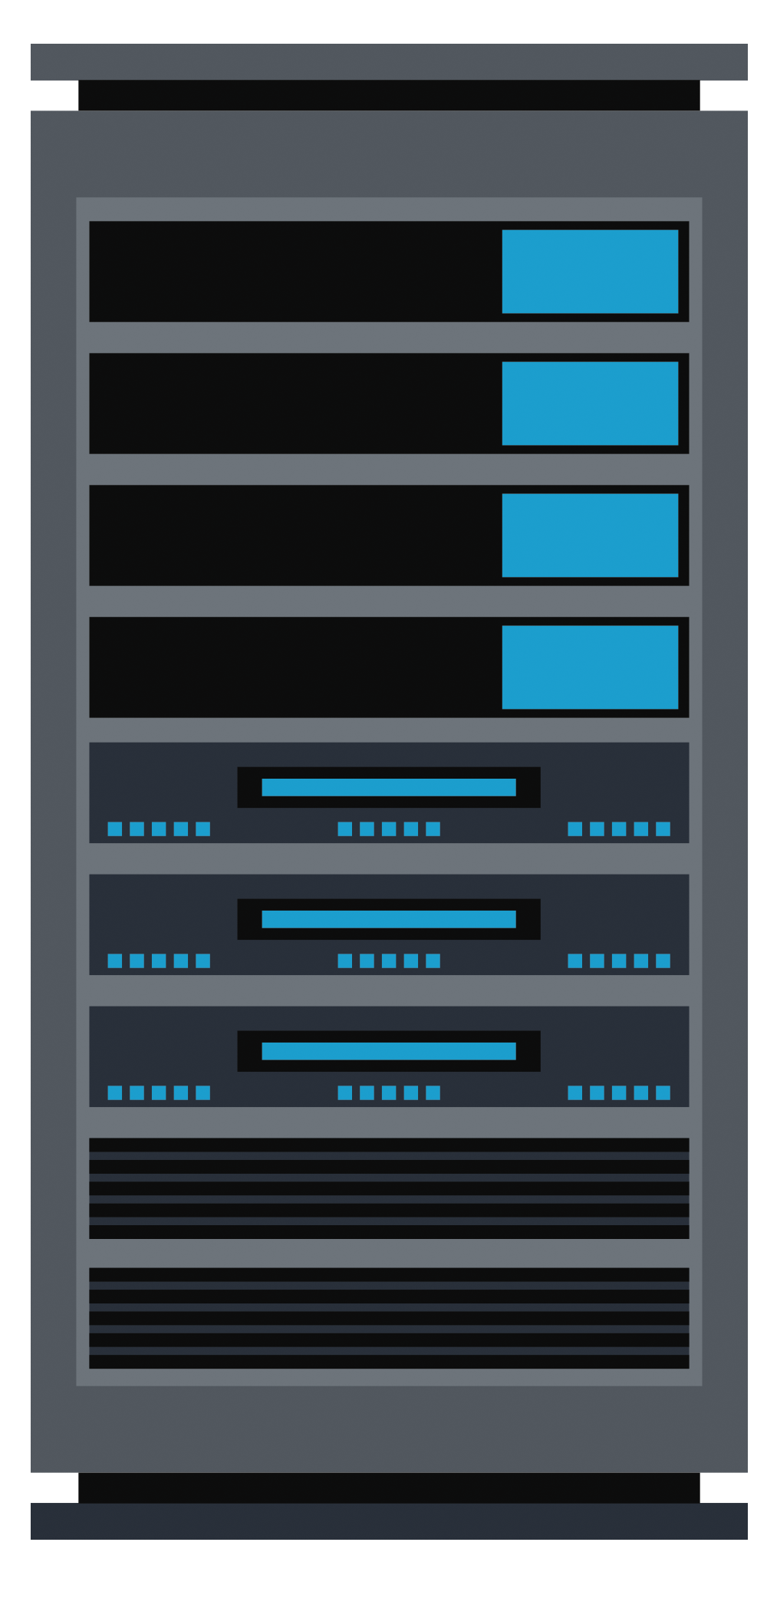
Mitigation Strategies: Validation Bypass
Access controls are only effective on the server side, where attackers cannot modify control checks and metadata.

Slide 16
Mitigation Strategies: Validation Bypass
Alternative methods of prevention include:
Implicitly deny all (except public resources).
Reuse access control mechanisms after implementation.
Disable web server directory listings, ensure backup files aren’t present in web roots.
Ensure logging of all access control failures and immediate generation of alerts.

Slide 17
Activity: Validation Bypass
In this activity, you will bypass input validation and then perform a SQL injection to exploit a vulnerability that you've discovered in a
company’s web server.
15 Minutes
17

Slide 18
18

Slide 19
Broken Authentication and Session Management
19

Slide 20
Application functions related to authentication and session management are often implemented incorrectly, allowing attackers to compromise passwords, keys, or session tokens, or to exploit other implementation flaws to assume other users’ identities temporarily or permanently.
—OWASP Top 10

Slide 21
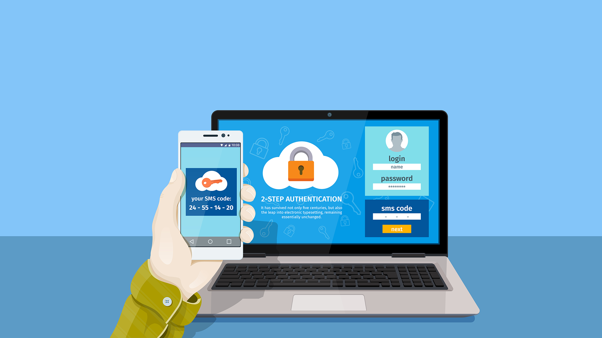
Broken Authentication
Flaws in the implementation of user authentication and session management have serious implications for businesses. A security breach can expose confidential information and create backdoors.
Notes:
shutterstock_639805240

Slide 22
Broken Authentication
The following implementation issues can lead to vulnerable web applications:
Automated attacks that allow brute-force or credential stuffing.
Allowing the use of well-known passwords, weak or default passwords.
Inefficient password recovery mechanisms.
Unencrypted passwords or weak hashes.
Absence of multifactor authentication.
Exposure of session ID in the URL.
Non-rotation of session IDs after each use.
Improper session invalidation or timeouts.
Inadequate security built into web application software.

Slide 23
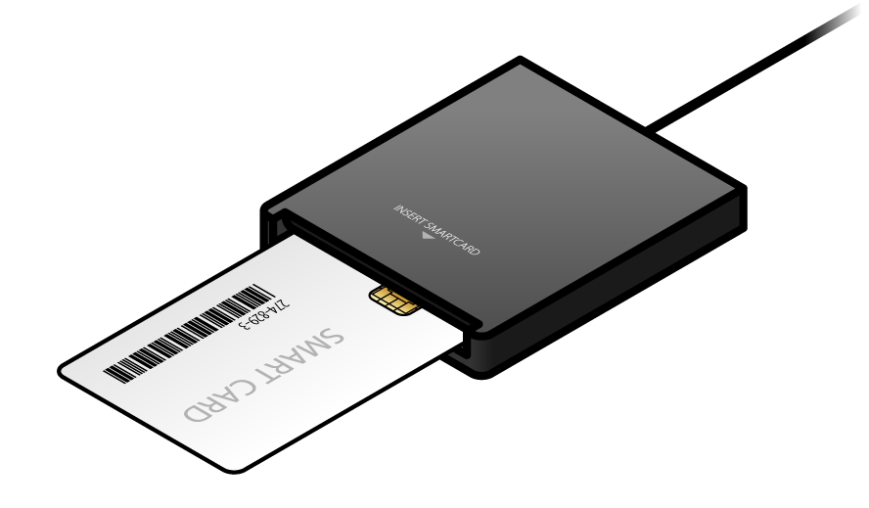
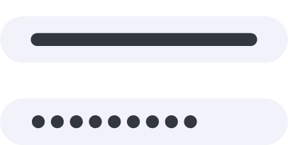


Broken Authentication Mitigation Strategies
We'll demonstrate how to perform a broken authentication and session management attack with the following scenario:
Factor 1
Standard login inputs (passwords, PIN, cognitive questions)
Factor 2
Physical keys (smartcards, hard tokens)
Factor 3
Biometrics (Iris/retina scans, hand geometry)
Factor 4
Location (GPS detection, callback to a home phone number)
Notes:
Image source: shutterstock_211765912

Slide 24


Broken Authentication Demo
We'll demonstrate how to perform an broken authentication and session management attack with the following scenario:
We’ll play the role of a junior security administrator working at FireFly Inc., a web application software developer.
We’ve been asked by the lead project engineer to do a few penetration tests against their website and provide remedial recommendations.

Slide 25
Broken Authentication Demo
We’ll cover the following attacks:
01
02
03
Insecure login forms existing in web page forms as a result of insecure web application programming.
Logout management, which allows previously logged out users to log back in by hitting the Back button.
Administrative portals, which reveal authentication mechanisms in the URL.

Slide 26
Broken Authentication
26

Slide 27
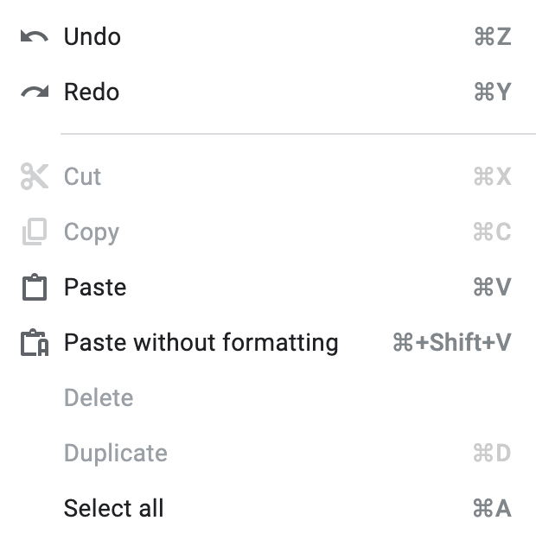

Broken Authentication Mitigation Strategies
Constrained user interface restricts what users can see and do based on their privileges.
Request edit access
You can only view this document. To make changes, ask the owner for edit access.
Context-dependent controls regulate activity-based functions, such as your ability to perform tasks like editing a document.
Content-dependent controls regulate the content of an object, such as grayed-out menu items.

Slide 28
Broken Authentication Mitigation Strategies
Polyinstantiation
API Keys
Assigns the storage of information at different classification levels, preventing hackers from understanding the information without the missing pieces.
Like passwords, should be treated as very sensitive information. They should always be stored in secure locations and transmitted only over encrypted communications channels.

Slide 29
Activity: Broken Authentication
In this activity, you will exploit a company’s broken authentication system and provide mitigation strategies.
20 Minutes
29

Slide 30
30

Slide 31
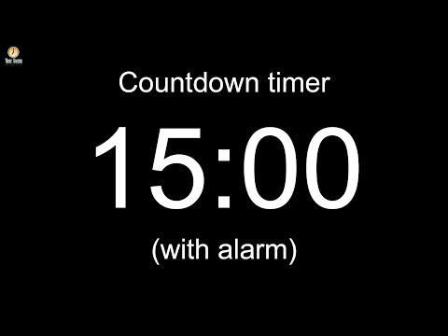
Notes:
Image source: AdobeStock_56885471
Break

Slide 32
Encoded Cookies
32

Slide 33

Cookies are typically sent using a type of encoding called base64.
Notes:
shutterstock_1295870983

Slide 34
Encoded Cookies
Base64 is an encoding scheme that represents a binary set of data in an ASCII string format.
ASCII characters
Transmission
Base64 encoding schemes are most common when data needs to be stored and transferred over media that is designed to deal with ASCII characters, such as web-based datastreams like URLs.
This encoding ensures that data remains intact throughout transmission without being modified.

Slide 35
Cookie Encoding
Once encoded, a username or password can be transmitted inside the URL in an ASCII string. This is what the underlying HTTP protocol expects to see.
user="eW91YXJldGhld2Vha2VzdGxpbms="; security_level=0; JSESSIONID=A77E31270D12B1FF01F773F8575B4D64; acopendivids=swingset,jotto,phpbb2,redmine; acgroupswithpersist=nada

Slide 36

We can decode this cookie using an online tool called CyberChef.
Notes:
shutterstock_1295870983

Slide 37
CyberChef
37

Slide 38


Code Quality
Developers often make notes such as TODO and FIXME within the application code throughout the software development life cycle (SDLC).
When developers forget to remove TODO and FIXME notes, they are putting an organization's web infrastructure at risk.
Since these notes identify flaws within the code, they can give attackers clues about vulnerabilities.

Slide 39
Code Quality
...
<div id ="lessonContent"><form accept-charset="Uknown" method="POST" name="form" action="attack?Screen=40&menu=700" enctype="<!-- FIXME: admin:adminpw --><!-- Use Admin to regenerate..." </div>
...
39

Slide 40



Code Quality Demo
In this demonstration, we’ll perform a code quality attack using the following scenario:
A hacktivist wants to hack into a web server to deface an organization's home page.
After doing some research, they discover that the developers are known to leave evidence of quality flaws in their web applications.
They will exploit these flaws by examining the underlying HTML code for any orphaned web developer notes.

Slide 41
Code Quality
Follow
Along
41

Slide 42
Basic Authentication
42

Slide 43



Basic Authentication
Basic authentication is used to protect server side resources as follows:
The client-side browser prompts the user for a username and password using a browser-supplied dialog box.
The web server sends a 401 authentication request with the response for the requested resource.
Username
Password
***********
The browser base64 encodes the username and password and sends those credentials back to the web server.
These credentials are automatically reset for each page protected with this mechanism, without requiring the user to enter their credentials again.

Slide 44

Code Quality Demo
In the next demonstration, we’ll extract passwords that are sent to the server during a 401 authentication request. We'll use CyberChef to decode them from base64-encoded into clear human-readable text. We'll use the following scenario:
An organization has recently experienced a large number of unauthorized logins outside of business hours.
You were hired as a pentester to identify the origin of these user authentication issues.
You believe this may be related to how cookies are handled during user authentication.

Slide 45
Basic Authentication
Follow
Along
45

Slide 46
Activity: The Challenge
In this activity, you will play the role of a pentester hired by a bank to test the security of the bank’s authentication scheme, sensitive financial data, and website interface.
This activity is part of this week’s homework and requires the use of tools and knowledge covered throughout the week.
Until End of Class (submit with the Unit 15 homework)
46

